Slide 1

Ant Lion Optimizer
Seyedali Merialili
Presented by:
Naman Singh

Slide 2
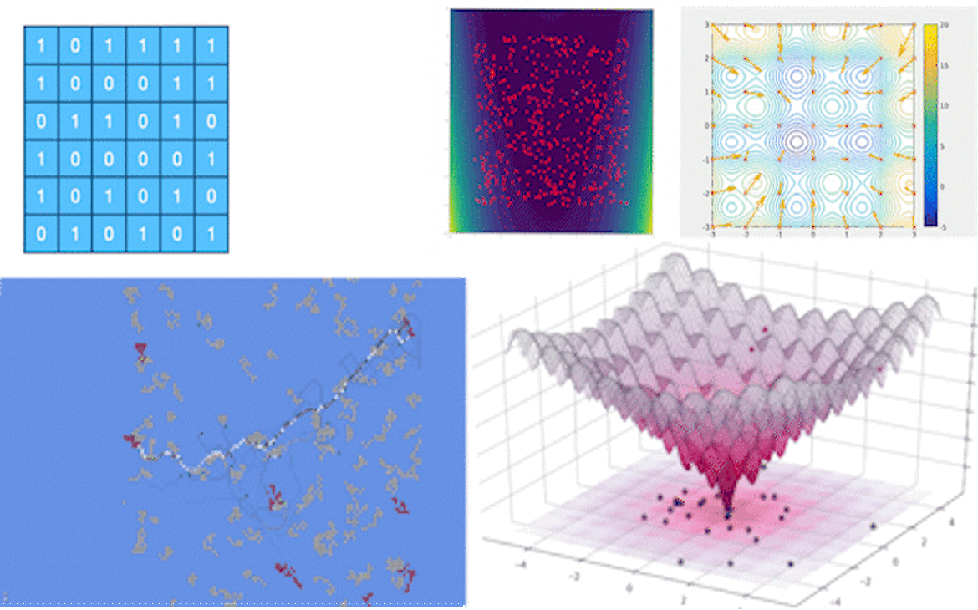
Objective
Problem Statement
Introduction to Metaheuristics
Meeting Antlion
Algorithm Inspiration
Operators of ALO algorithm
Algorithm
Benchmarking
Conclusion

Slide 3
Problem Statement
We are trying to solve the 3 classical engineering problems:
1. Three-bar Truss design
2. Cantilever beam design
3. Gear train design

Slide 4
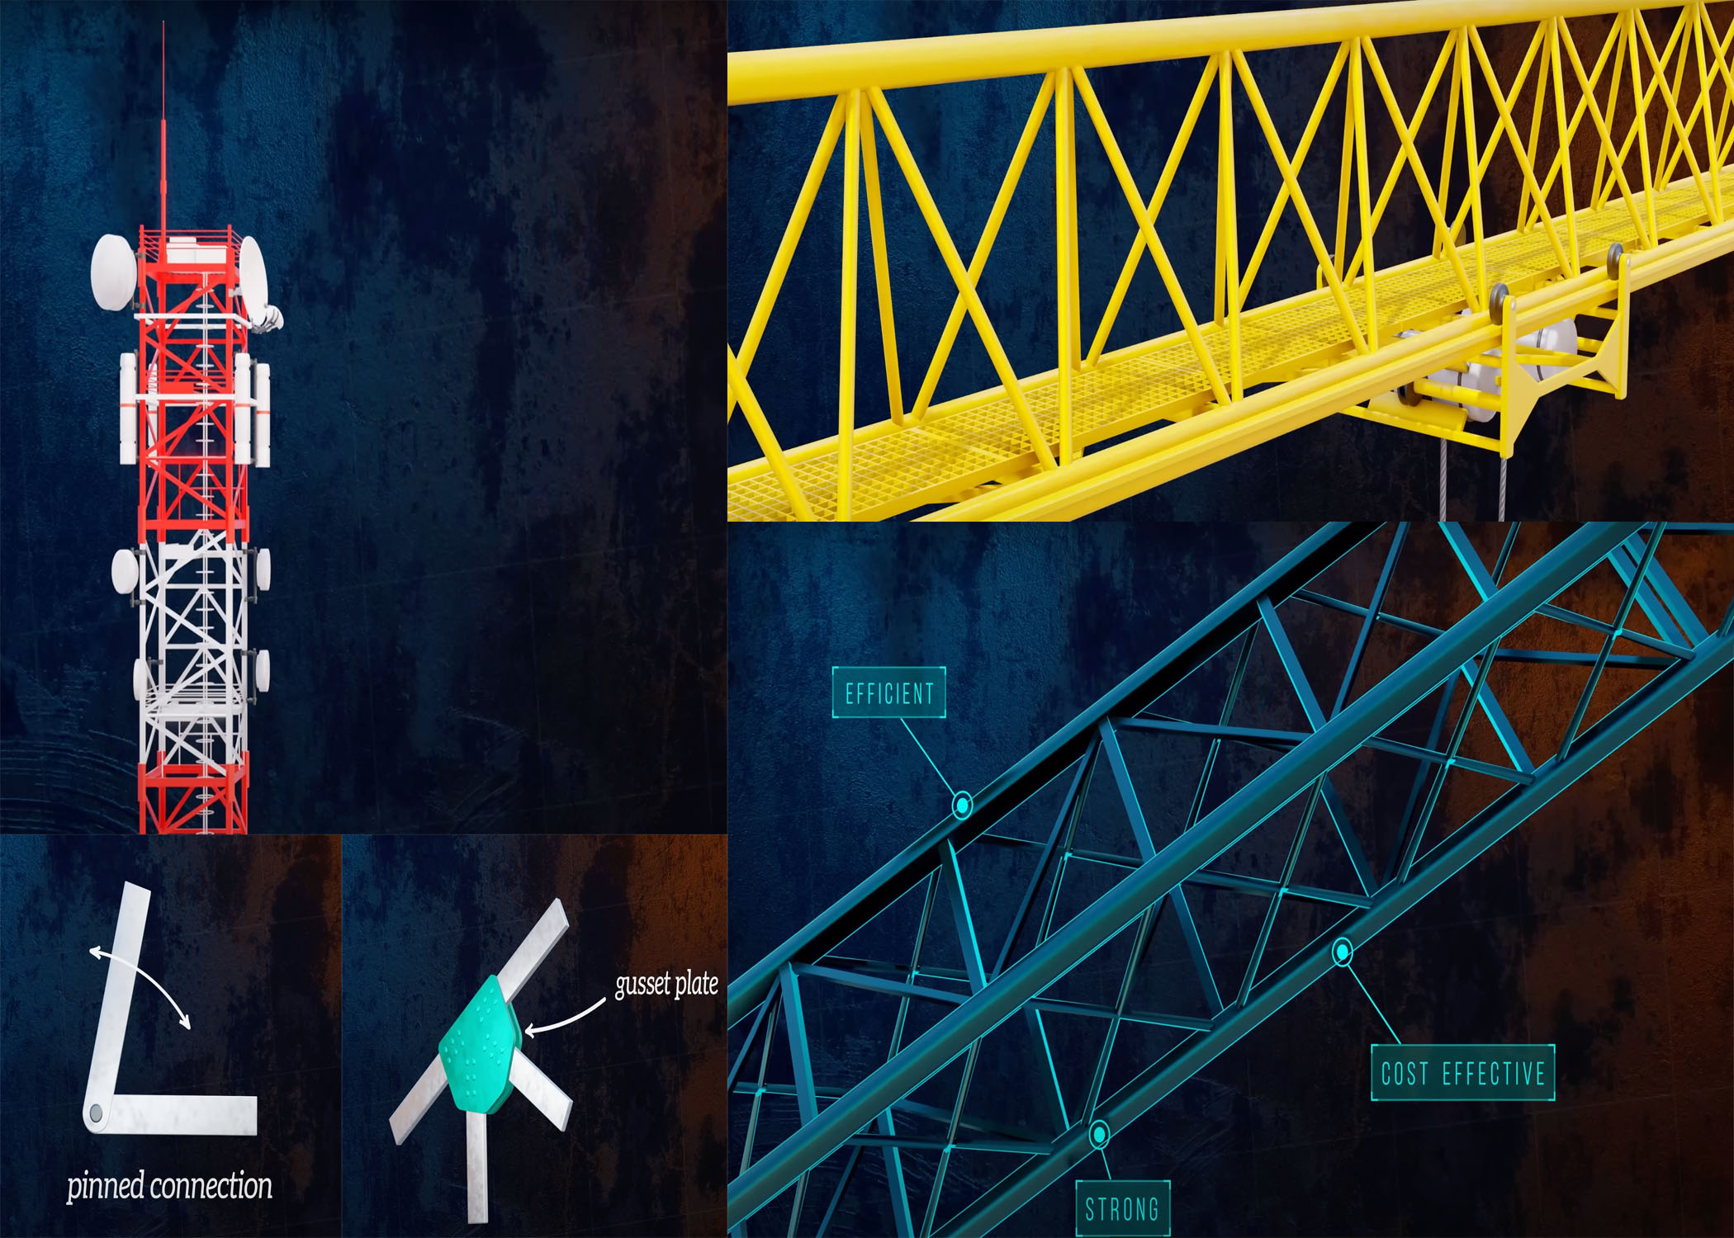
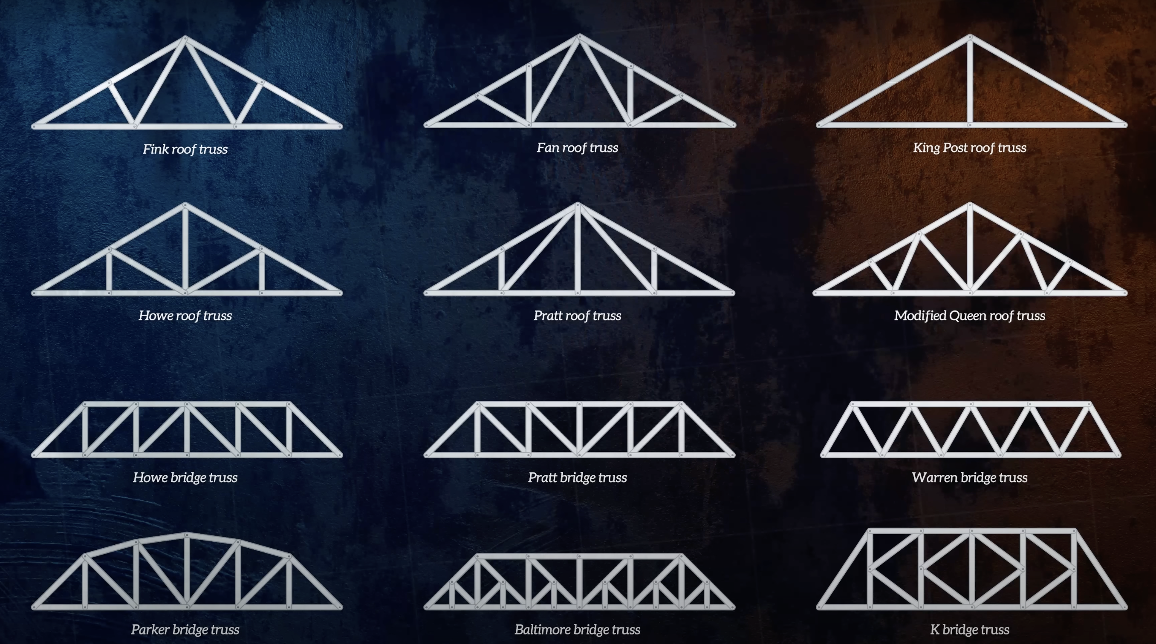
Three-bar truss design
Design a three-bar truss to minimize its weight.

Slide 5
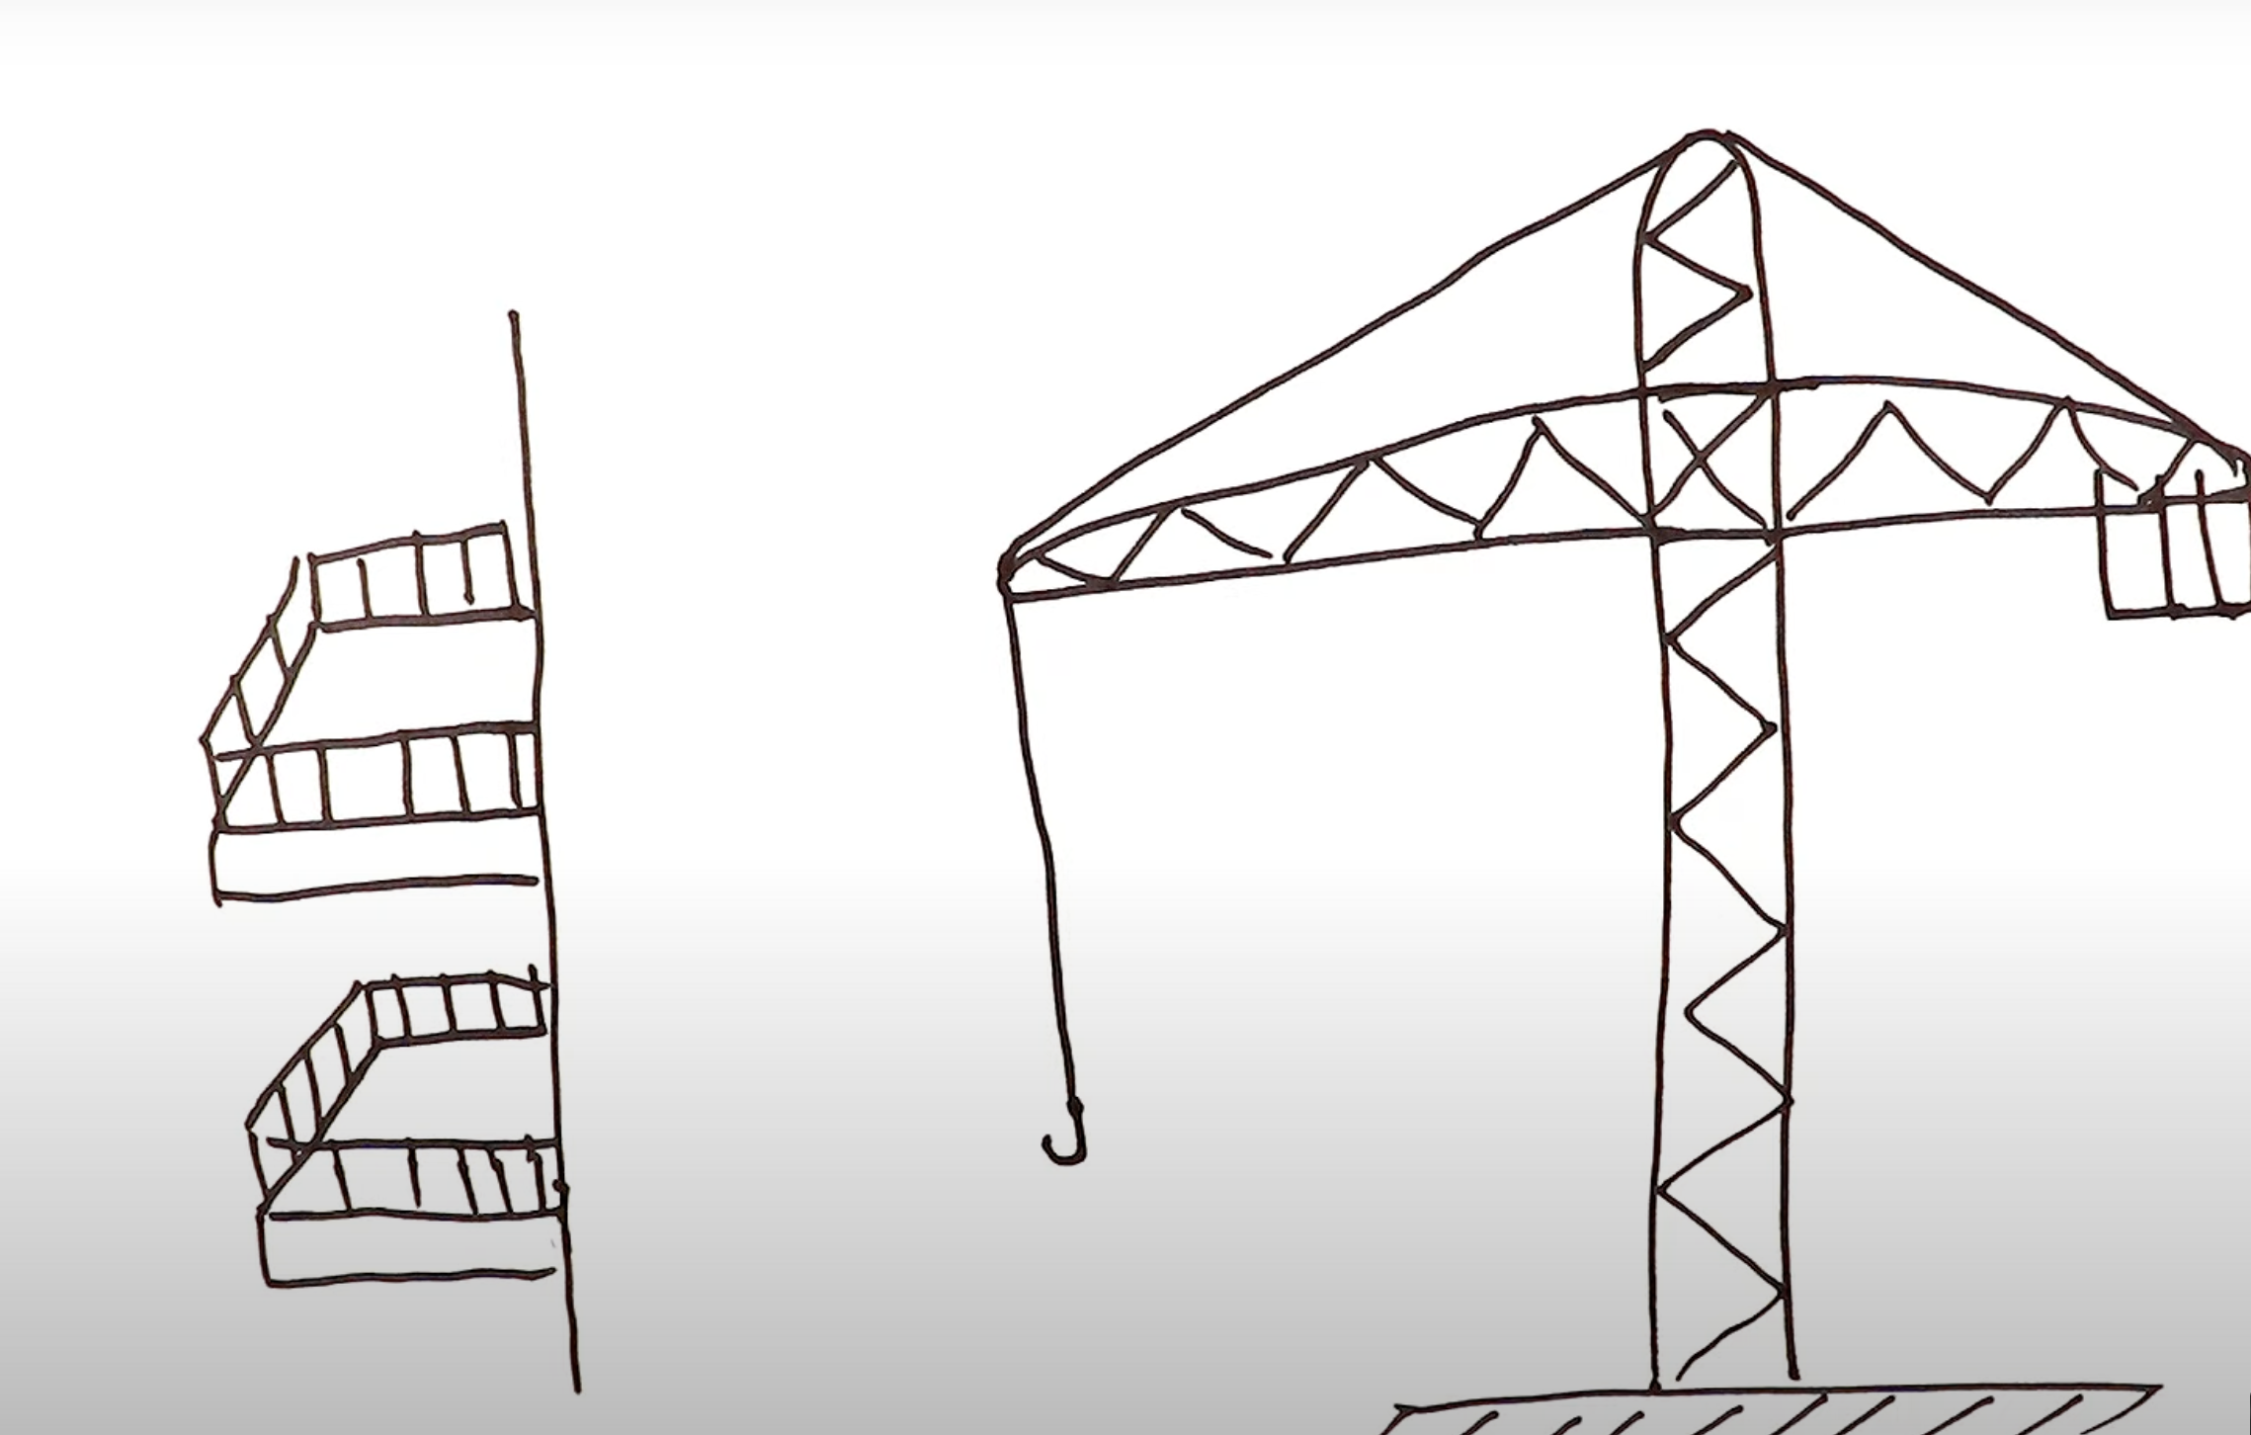
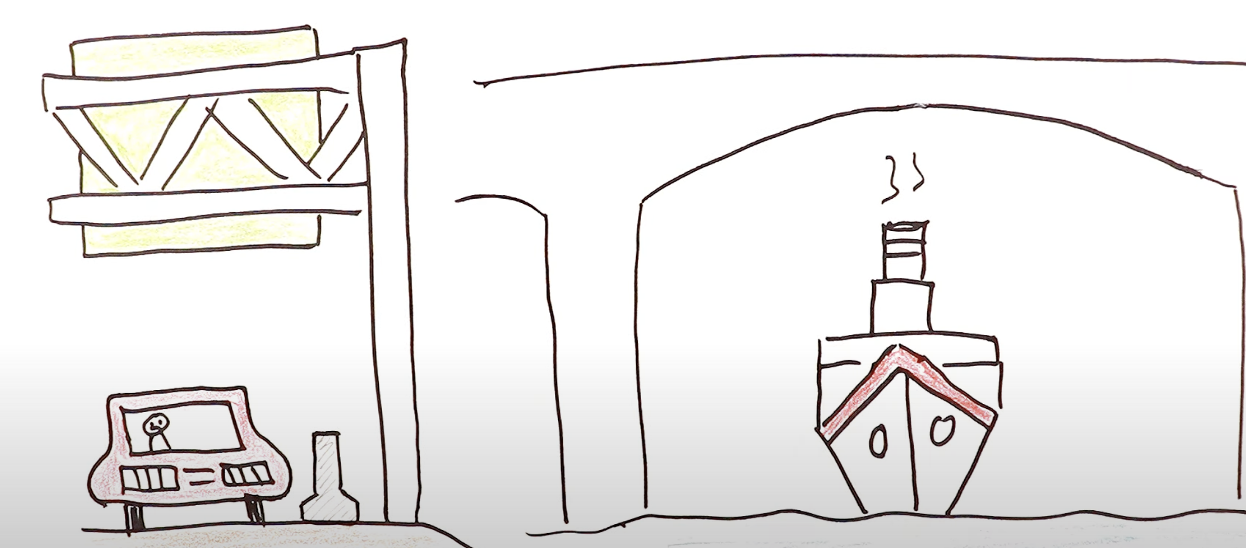
Cantilever beam design
Cantilever beam design focuses on optimizing the structural configuration and material selection to achieve the
desired strength, stiffness, and deflection characteristics for a given application.

Slide 6
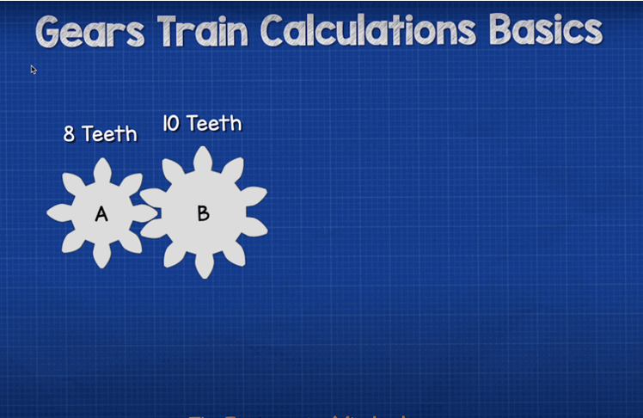
Gear train design problem
The objective is to find the optimal number of tooth for four gears of a train for minimizing the gear ratio.
Gear train optimization involves
maximizing the efficiency and
performance of gear systems through careful design
selection of gear ratios and configurations.

Slide 7
Introduction to Metaheuristic Algorithm
Metaheuristic algorithms are primary techniques for real engineering design optimization problems.
They leverage stochastic operators, distinguishing them from deterministic approaches.
Deterministic algorithms tend to get trapped in local optima, limiting their effectiveness.
Stochastic Optimization Algorithms
Stochastic algorithms, like evolutionary algorithms, employ randomness in seeking global optima.
They avoid local solutions more effectively than deterministic methods.
Different solutions are obtained in each run due to their randomized nature.
Advantages
Popular Metaheuristic Algorithms
Evolutionary algorithms create random solutions and iteratively improve them to approximate the global optimum.
They are problem and derivation independent, simplifying optimization processes.
High local optima avoidance due to stochastic nature.
Genetic Algorithm
Particle Swarm Optimization
Ant Colony Optimization
Differential Evolution
Evolutionary Programming.
3

Slide 8
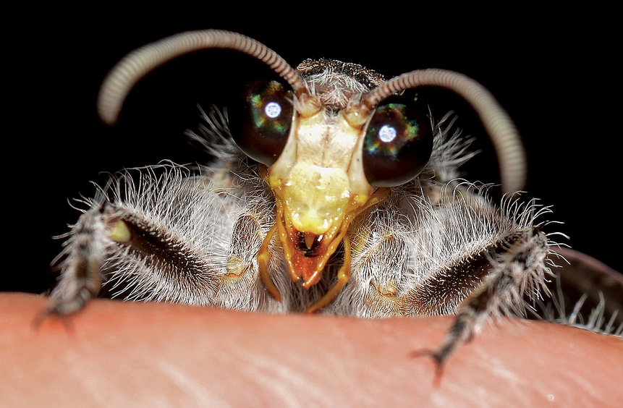
Hello There!!
2
Revised September 2023

Slide 9
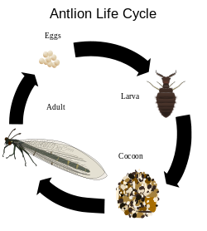
Antlion as Observed in Nature
- Antlions belong to the Myrmeleontidae family within the Neuroptera order.
Their lifecycle comprises two main phases: larvae and adult.
Larvae predominantly spend their time in sand pits hunting prey, while adults focus on reproduction.
4

Slide 10
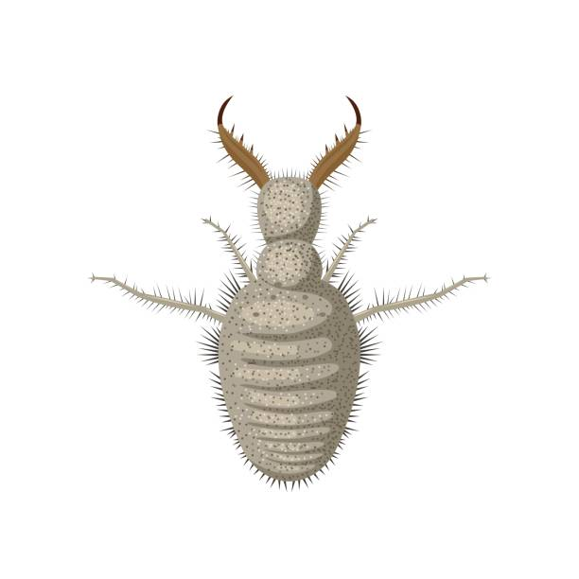
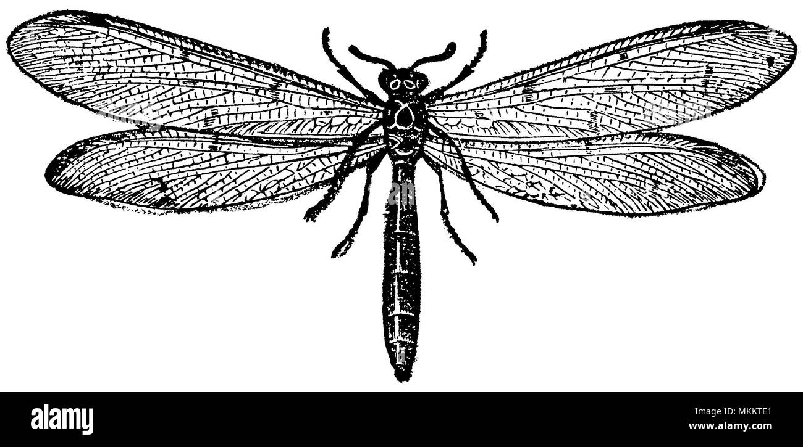
My life through stages
Larval Stage
Adult Stage
Larvae are the primary hunters, spending up to three years in this stage.
They construct cone-shaped pits in sandy environments using a unique circular movement.
Pits serve as traps for unsuspecting prey, primarily ants, utilizing a sit-and-wait predation strategy.
Adults have a short lifespan of 3-5 weeks.
Their main purpose is reproduction, contributing to the continuation of the species.

Slide 11
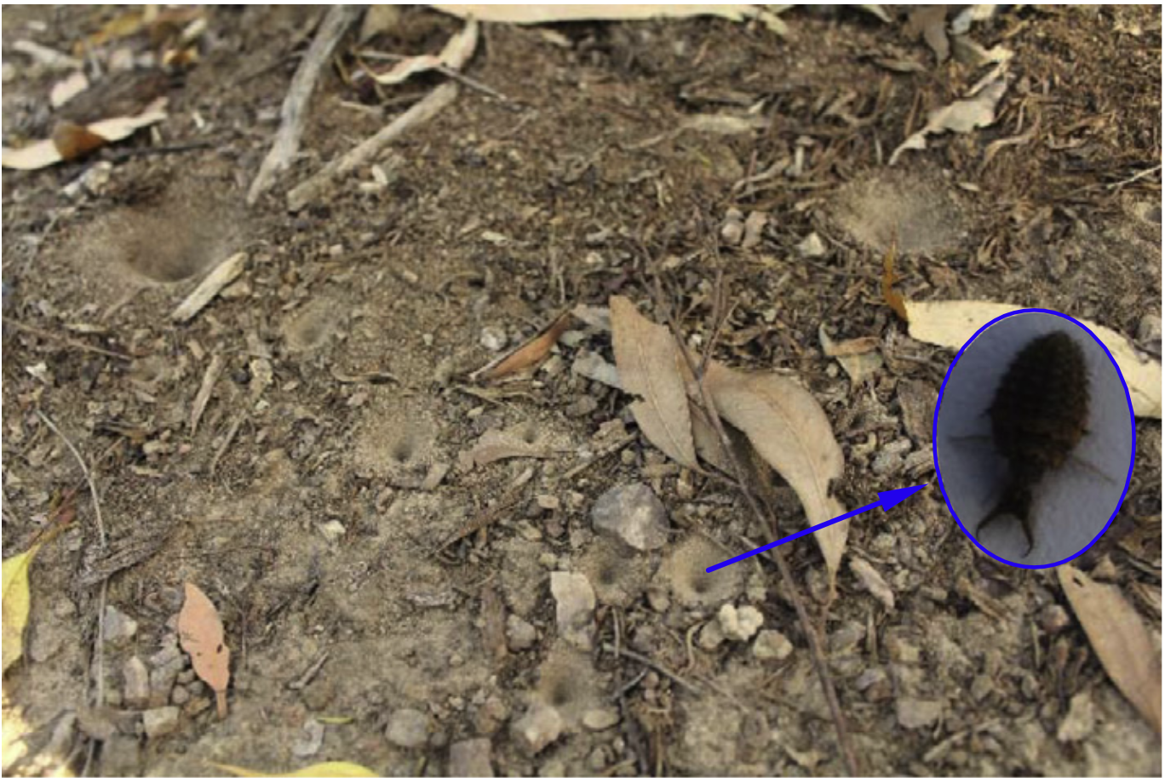
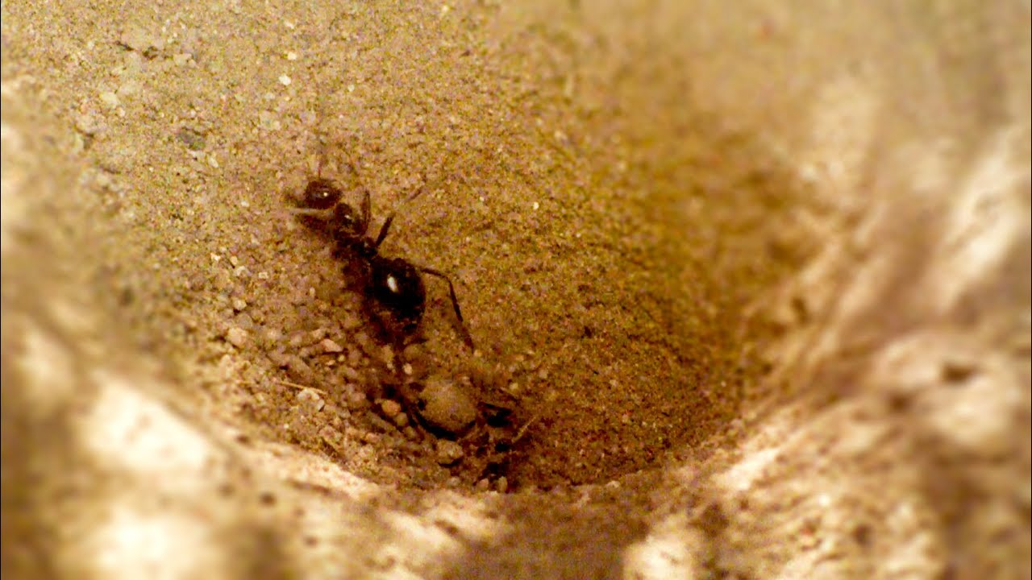
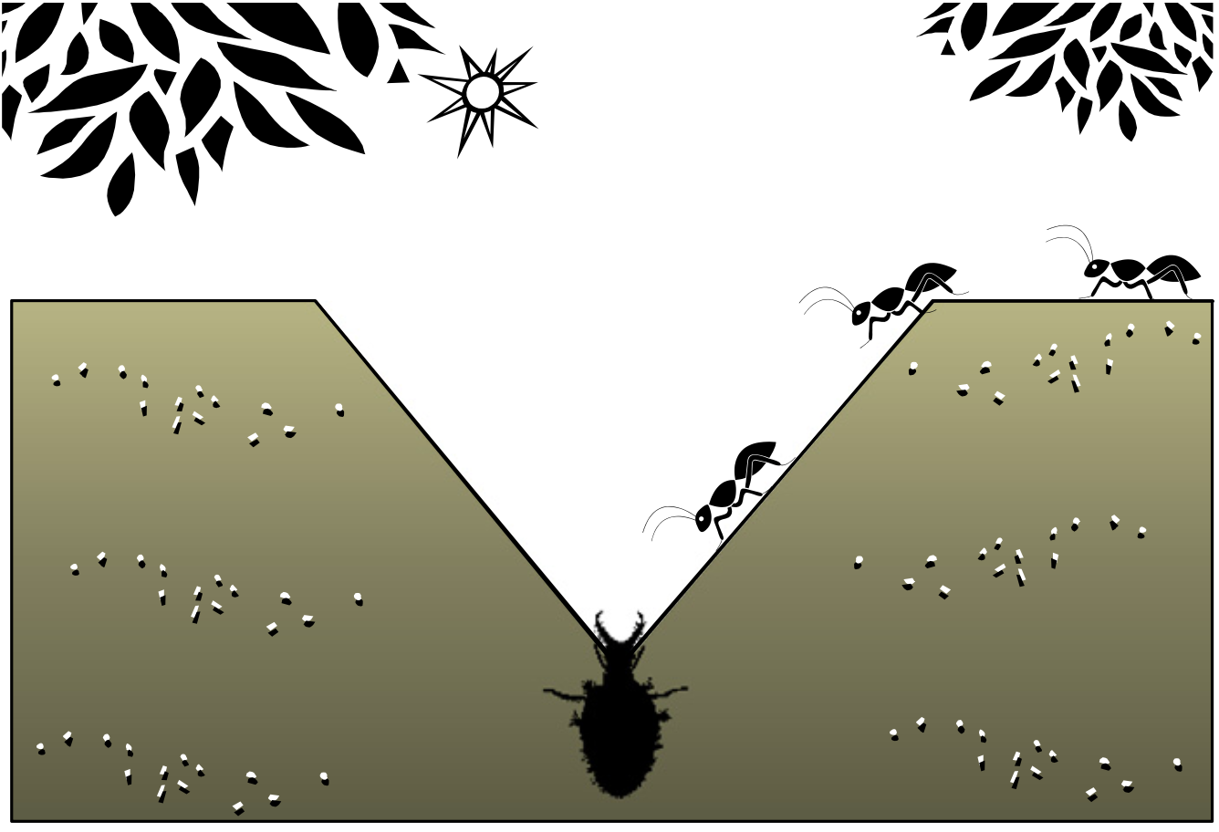
Hunting behavior of Antlion
Construction of cone-shaped pits in sand.
Sit-and-wait predation strategy.
Use of massive jaw to throw out sand and create traps.
Prey Capture Mechanism:
Larvae wait for insects, especially ants, to fall into the pit.
Intelligent use of sand to slide prey into the bottom of the pit.
Consumption of captured prey by pulling them under the soil.

Slide 12
Algorithm Inspirations
ALO mimics the hunting mechanism of antlions in nature.
ALO implements five main steps of hunting prey:
Random walk of ants
Building traps
Entrapment of ants in traps
Catching preys
Re-building traps

Slide 13
As its name implies, the ALO algorithm mimics the intelligent behavior of antlions in hunting ants in nature.
The ALO algorithm is inspired by biological and sociological motivations and can take care of optimality on rough, discontinuous and multi-modal surfaces.
The ALO has three main advantages: it can find near optimal solution regardless the initial parameter values, its convergence is fast and it can handle integer and discrete constraints.
It has successfully been applied and studied to many artificial and real optimization problems.

Slide 14
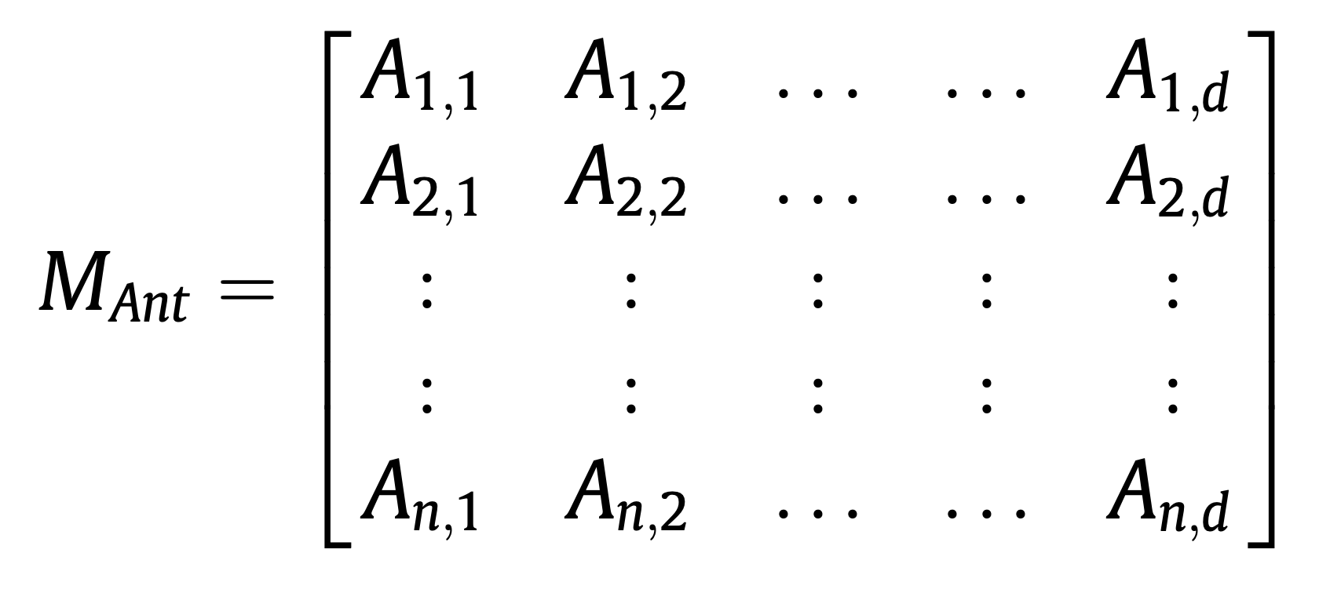
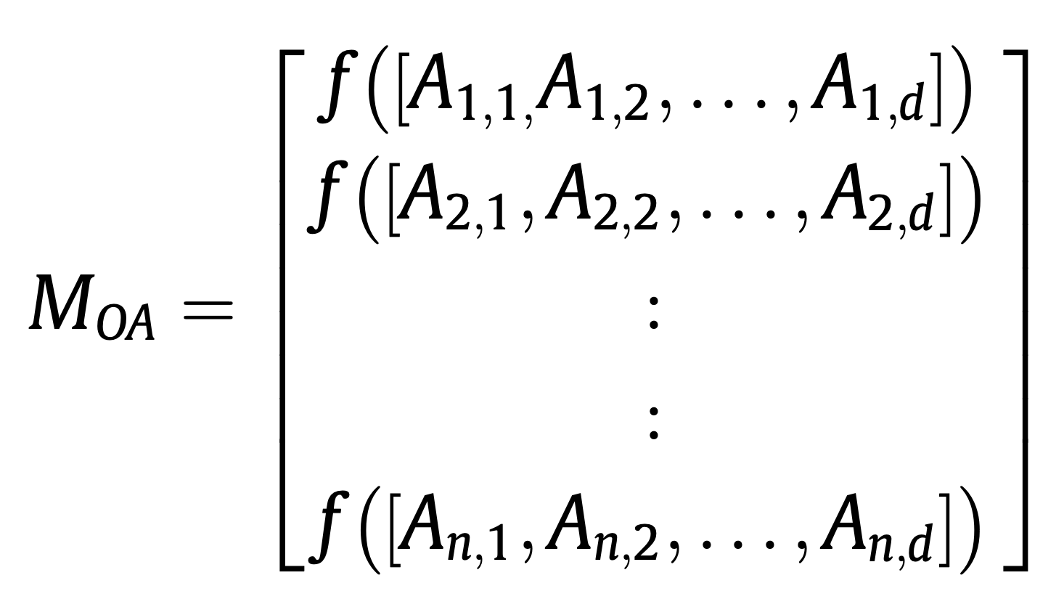
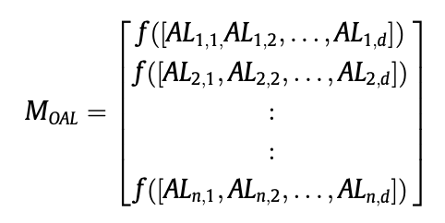
Operators of ALO algorithm Algorithm
Operators of the ALO Algorithm:
1. Movement of Ants: MATRIX: M_{Ant}
Ants navigate the search space using different random walks.
Random walks are applied to all dimensions of ants' positions.
The position of each ant is stored in the M_{Ant} matrix:
M_{Ant}: Matrix for saving the position of each ant.
2. Fitness Evaluation for Ants: Matrix M_{oa}
Fitness function is utilized to evaluate the performance of each ant.
M_{oa}: Matrix for saving the fitness of each ant.
3. Fitness Evaluation for Antlion: Matrix M_{oal}
Fitness function is utilized to evaluate the performance of each antlion.
Fitness values are stored in the Moal matrix:
M_{oal}: Matrix for saving the fitness of each antlion.
5

Slide 15
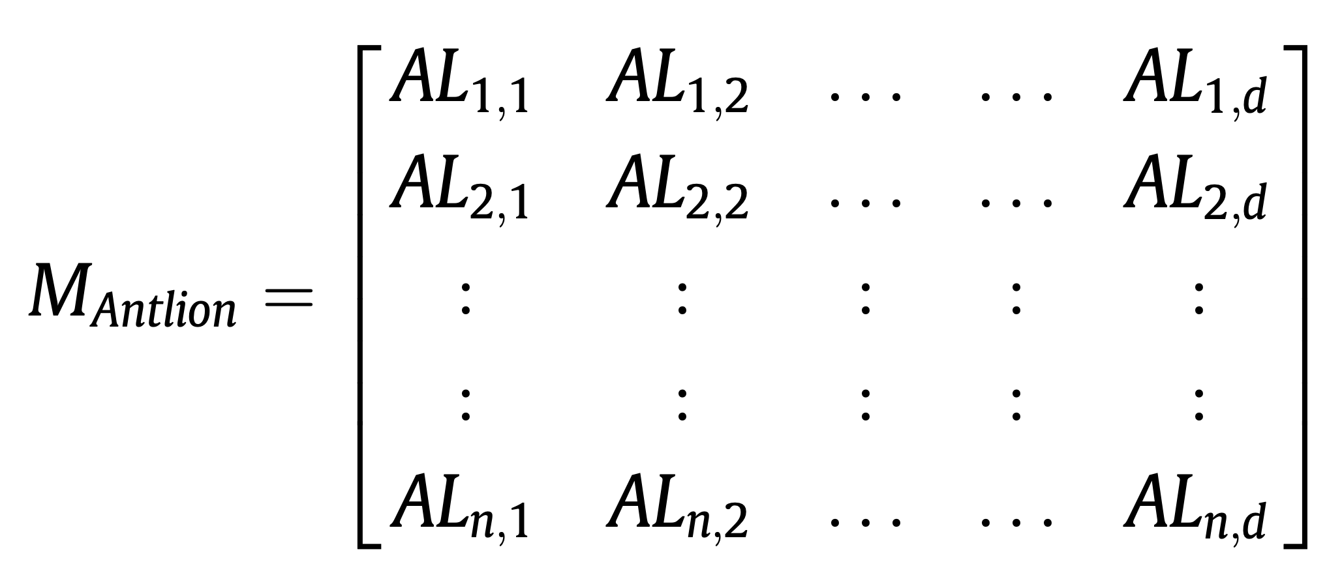
Matrices
4. Movement of Antlions: Matrix M_{antlion}
- Antlions construct pits proportional to their fitness, with higher fitness leading to larger pits.
- Larger pits increase the likelihood of catching ants.
- Antlions reposition themselves based on the latest caught prey to improve their hunting success.
5. Interaction between Ants and Antlions:
Ants can be caught by antlions during each iteration.
If an ant becomes fitter than an antlion, it is considered caught and pulled under the sand.
Antlions reposition themselves to the location of the latest caught prey and build larger pits for subsequent hunts.
6. Adaptive Random Walk:
- The range of random walks decreases adaptively to simulate ants being drawn towards antlions.
- This adaptive mechanism enhances the likelihood of ants encountering antlion traps.
These operators facilitating efficient exploration and exploitation of the search space during optimization.
U.
Revised September 2023

Slide 16
Algorithm

Slide 17
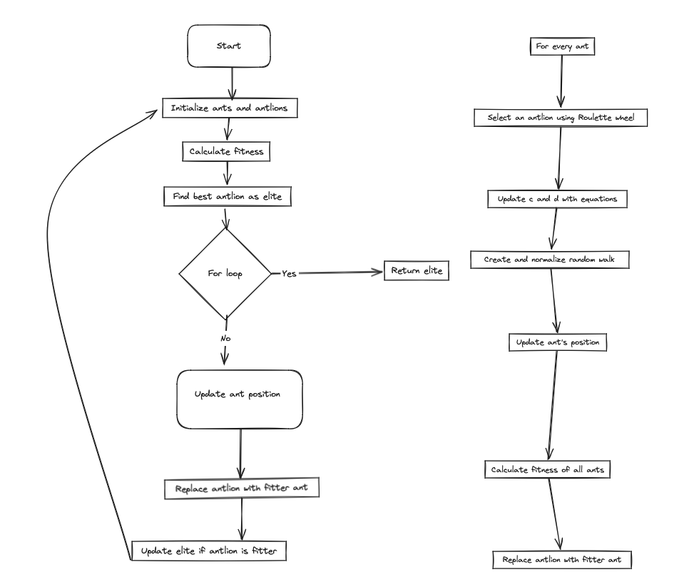
Notes:
Problem: Design a cantilever beam with maximum structural stability while keeping its weight within a certain limit.
Given Parameters:
- Maximum weight of the beam: 100 units
- Structural stability requirement: 50 units (on a scale of 0 to 100, where 100 indicates maximum stability)
Using the Antlion Optimization (ALO) Algorithm:
1. Initialization:
- Initialize a population of ants and antlions randomly.
- Define the ranges of variables for the beam design (e.g., thickness of each element).
2.*Main Loop:
- Iterate until the end criterion is satisfied:
- For each ant:
- Select an antlion using the Roulette wheel selection method.
- Update the position of the ant by creating a random walk within the defined ranges.
- Calculate the fitness of the ant based on its beam design (e.g., weight and structural stability).
- Replace an antlion with its corresponding ant if it becomes fitter.
- Update the elite antlion if any antlion becomes fitter than the current elite.
3. **End Criterion**:
- The algorithm stops when a certain number of iterations are completed or when a satisfactory solution is found.
4. **Return**:
- Return the elite antlion, which represents the optimal beam design with maximum structural stability while adhering to the weight limit.
Example:
Let's say we have 5 variables representing the thickness of each element of the beam. The algorithm will iteratively adjust these thickness values to optimize the beam's weight and structural stability. At each iteration, the ants and antlions will interact, with ants representing different beam designs and antlions representing traps that evaluate these designs. Through iterations, the algorithm converges towards the optimal beam design that meets both weight and structural stability requirements.

Slide 18
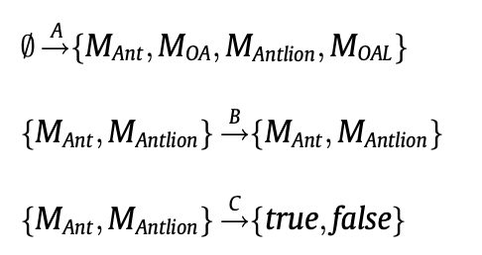
where A is a function that generates the random initial solutions.
B manipulates the initial population provided by the function A
C returns true when the end criterion is satisfied.

Slide 19
Conditions during Optimization
Ants move around the search space using different random walks.
Random walks are applied to all the dimension of ants.
Random walks are affected by the traps of antlions.
Antlions can build pits proportional to their fitness (the higher fitness, the larger pit).
Antlions with larger pits have the higher probability to catch ants.
Each ant can be caught by an antlion in each iteration and the elite (fittest antlion).
The range of random walk is decreased adaptively to simulate sliding ants towards antlions.
If an ant becomes fitter than an antlion, this means that it is caught and pulled under the sand by the antlion.
An antlion repositions itself to the latest caught prey and builds a pit to improve its change of catching another prey after each hunt.
7
Revised September 2023

Slide 20
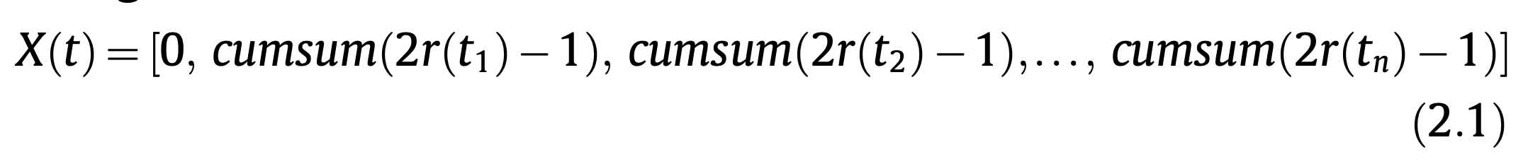
Random Walk
Antlion-Ant Interaction:
The ALO algorithm models the interaction between antlions and ants within a trap.
Ants move over the search space, while antlions hunt them using traps to become fitter.
Equation 2.1: Random Walk
Equation (2.1) generates random steps for ants at each iteration of optimization.
n represents the maximum number of iterations
t indicates the step of the random walk.

Slide 21
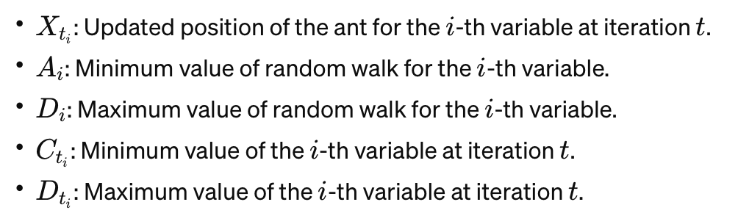
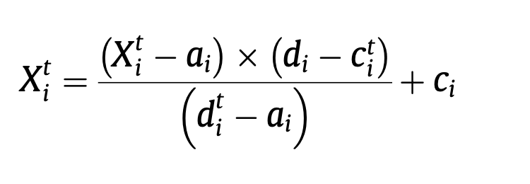
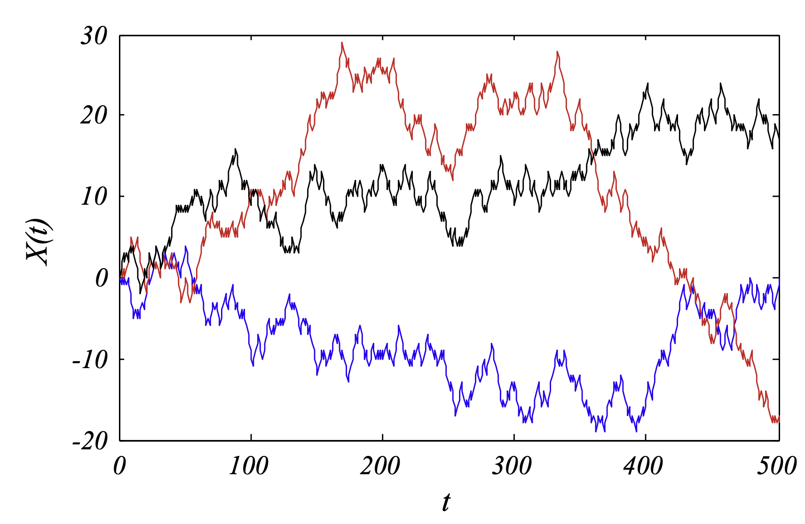
Equation 2.2: Normalized Equation for Random walk: Normalization to Boundaries
Random walks need to be normalized to ensure ants stay within the search space.
Employs min-max normalization.
This ensures that the random walks of ants remain within the boundaries of the search space throughout the optimization process.

Slide 22
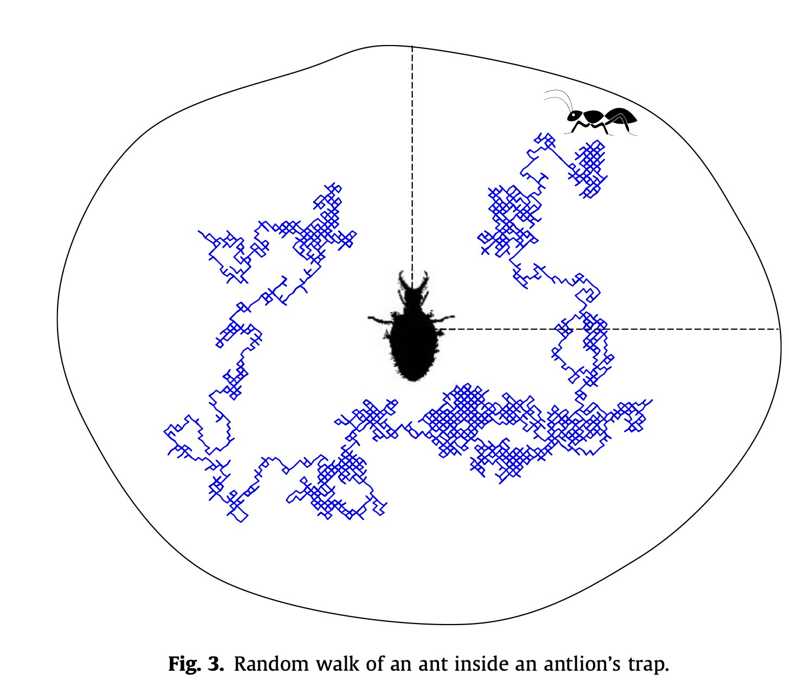
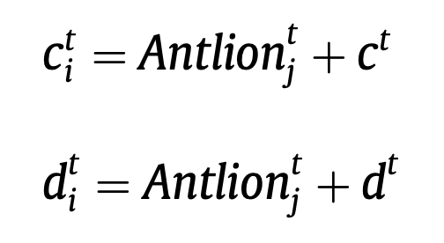
Trapping in antlion’s pits
Mathematical Modeling:
Antlions' traps affect the random walks of ants in the search space.
To mathematically model this interaction, Equations (2.8) and (2.9) are proposed.
Equations for Trapping:
define the boundaries for ants' random walks.
Effect on Ants' Random Walks:
Here we confine ants' movement within a hypersphere around the selected antlion.
This constraint reflects the influence of antlions' traps on the exploration of the search space by ants.
The confinement of ants' random walks by antlions' traps enhances the convergence and efficiency of the optimization process.
It ensures that ants focus their exploration efforts around promising regions of the search space identified by antlions.
c^{t}_{i}​ represents the minimum values of all variables at the t_{i} th iteration.
d^{t}_{t}​ indicates the maximum values.
c^{t} and d^{t} are vectors representing the range around the selected antlion.

Slide 23
Building Trap
In order to model the antlions’s hunting capability, a roulette wheel is employed.
As Fig. 3 show ants are assumed to be trapped in only one selected antlion.
The ALO algorithm is required to utilize a roulette wheel operator for selecting antlions based of their
fitness during optimization.
This gives high chances to the fitter antlions for catching ants.

Slide 24
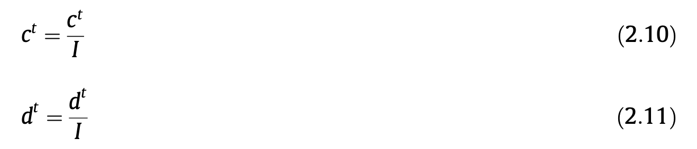
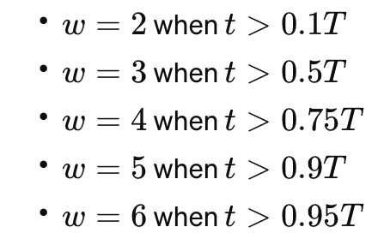
Sliding ants towards antlion
Behavior Description:
Antlions utilize sand-shooting behavior to slide trapped ants towards the center of their pits, preventing escape.
Mathematical Model:
propose an adaptive decrease in the radius of ants’ random walks hypersphere to mimic this behavior.
Adaptive Ratio Calculation:
I= 10^{w t/T}
t is the current iteration
T is the maximum number of iterations.
w is a constant that adjusts based on the current iteration to fine-tune the adaptation.
Accuracy Level Adjustment:
Constant w influences the rate of radius decrease, allowing for control over the exploitation accuracy level.
Illustrative Visualization:
Figure 4 depicts the decreasing behavior using Equations (2.10) and (2.11), mimicking the sliding process of ants inside the pits.

Slide 25
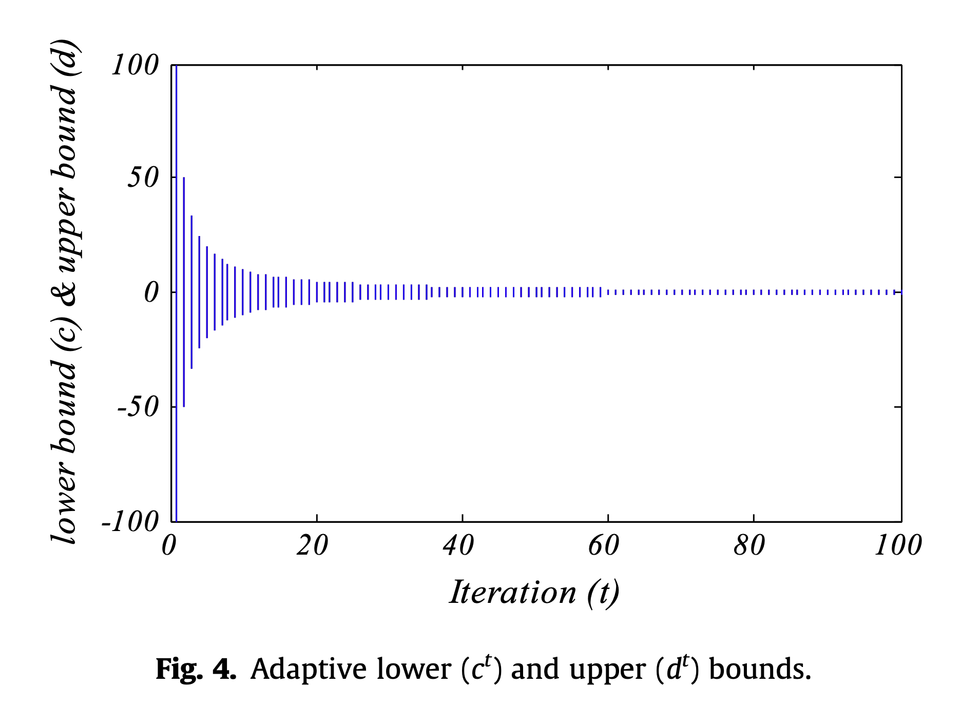

Slide 26
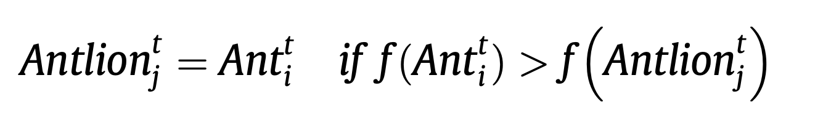
Catching prey and re-building the pit
Catching Prey and Re-building the Pit:
Final Stage of Hunt:
- When an ant reaches the bottom of the pit and is caught in the antlion's jaw, it marks the final stage of the hunt.
- The antlion then pulls the ant inside the sand and consumes its body, completing the hunting process.
Mimicking the Process:
- To simulate this process in the optimization algorithm, it's assumed that catching prey occurs when an ant becomes fitter than its corresponding antlion.
- When an ant is caught, the antlion updates its position to the latest position of the hunted ant to enhance its chance of catching new prey.
Proposed Equation:
- t shows the current iteration
-Antlion^{t}_{j} shows the position of selected j^{th} Antlion at t^{th} iteration
- Ant^{t}_{i} indicates the position of i^{th} ant at t^{th} iteration.
By incorporating this equation into the algorithm, the antlions adaptively adjust their positions based on successful prey catches, thereby improving their hunting efficiency and increasing the likelihood of capturing new prey.

Slide 27
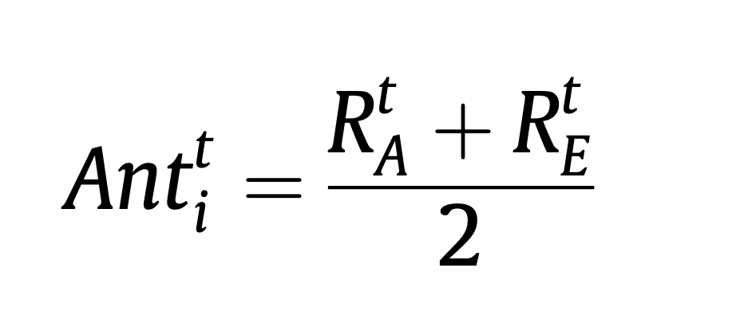
Elitism
Significance in Evolutionary Algorithms:
- Elitism is a crucial feature in evolutionary algorithms, preserving the best solution(s) attained throughout the optimization process.
Implementation in the Study:
- In this study, the best antlion obtained in each iteration is saved and regarded as an elite.
- The elite represents the fittest antlion, capable of influencing the movements of all ants during iterations.
Elite's Influence on Ants:
- Every ant randomly moves around a selected antlion chosen by the roulette wheel and the elite simultaneously.
Equation for Ant Movement:
Combined Influence:
- By averaging the random walks around both the selected antlion and the elite, ants are guided in their movement, benefiting from the collective influence of both.
Enhancing Exploration and Exploitation:
- Incorporating elitism ensures that the optimization process balances exploration of new solutions and exploitation of promising regions in the search space, leading to improved convergence towards optimal solutions.
- R^{t}_{a} is the random walk around the antlion selected by the roulette wheel at t^{th} iteration
- R^{t}_{E} is the random walk around the elite at t^{th} iteration.
- Ant^{t}_{i} indicates the position of i^{th} ant at t^{th} iteration.

Slide 28
The ALO algorithm has several key features that enable it to effectively approximate the global optimum of optimization problems:
Exploration and Exploitation:
Exploration is done by random walks of ant and antlion.
Exploitation is done by adaptive shrinking boundaries of antlions' traps.
2. Local Optima Avoidance: Using random walks and the roulette wheel selection mechanism.
3. Population-based Approach: high capacity for avoiding local optima and exploring diverse solutions.
4. Convergence Guarantee: The intensity of ants' movement is adaptively reduced over iterations, facilitating convergence of the algorithm.
5. Promotion of Diversity: By calculating random walks for every ant and dimension, ALO promotes diversity within the population, enhancing exploration capabilities.

Slide 29
6. Effective Guidance: Antlions relocate to the positions of the best ants guides search towards promising regions.
7. Utilization of Elite: The best antlion in each iteration is saved and compared to the best antlion obtained so far (elite), enabling effective utilization of promising solutions.
8. Few Adjustable Parameters: Minimal number of parameters to adjust, simplifying its implementation and tuning process.
9. Gradient-Free Approach: ALO treats the optimization problem as a black box, making it suitable for problems where gradients are unavailable or impractical to compute.

Slide 30
Benchmarking Phase
ALO is benchmarked in three phases:
Testing on 19 mathematical functions.
Solving classical engineering problems (three-bar truss design, cantilever beam design, and gear train design).
Optimizing ship propeller shapes as challenging constrained real problems.
Performance Evaluation
ALO is compared with various algorithms in the literature.
Results show competitive performance in terms of improved exploration, local optima avoidance, exploitation, and convergence.
Superior optimal designs are obtained for classical engineering problems, indicating merit in solving constrained problems with diverse search spaces. Optimal shapes of ship propellers demonstrate applicability in solving real problems with unknown search spaces.

Slide 31
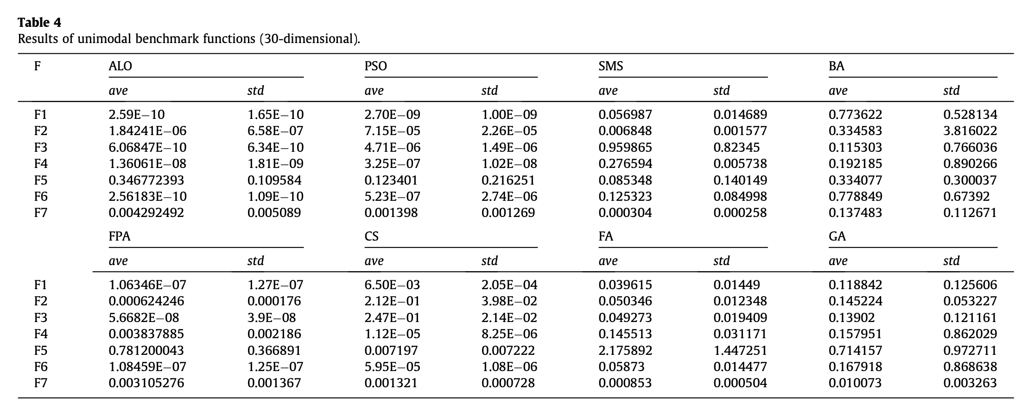
Unimodal
ALO outperforms other algorithms on unimodal test functions, as indicated by Table 4.
Statistically significant p-values in Table 5 confirm ALO's effectiveness in exploitation, leading to rapid convergence towards the optimum.

Slide 32
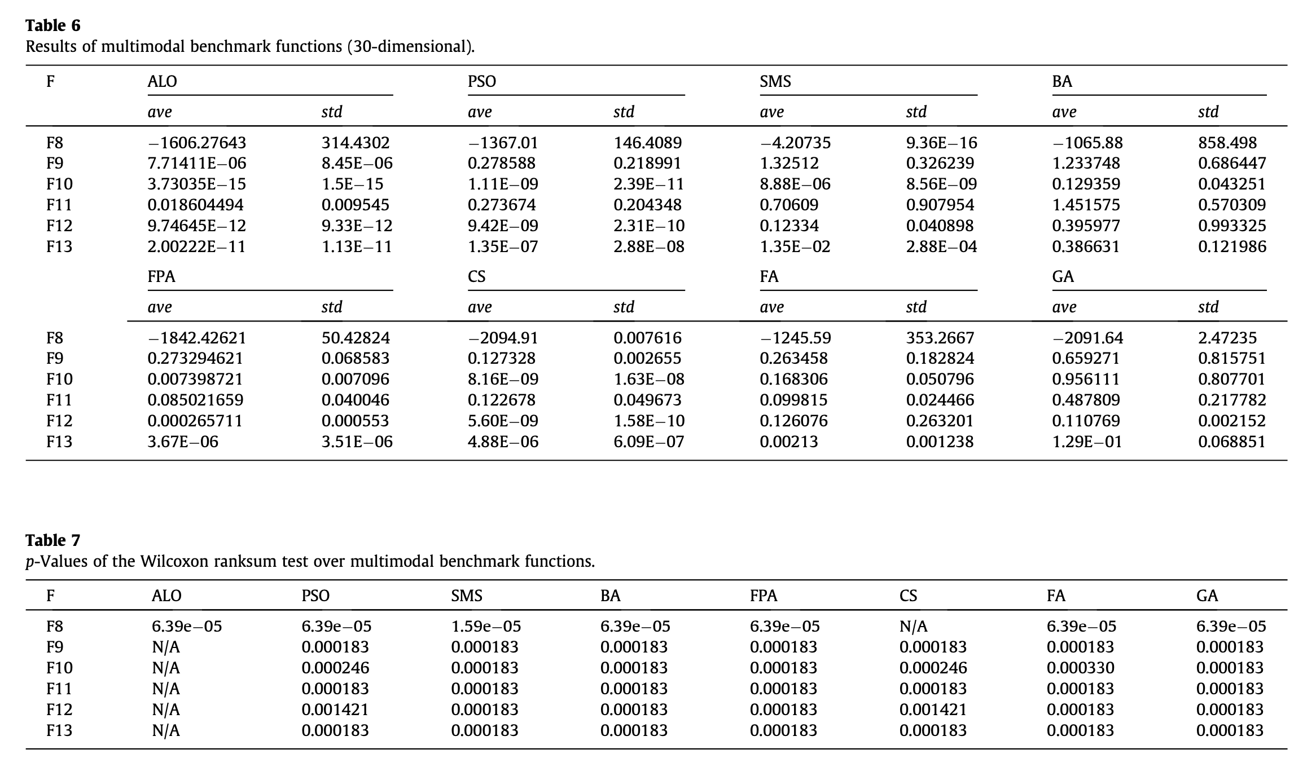
Multimodal
ALO achieves impressive results on multi-modal test functions, securing the best performance on four out of the test functions (Table 6).
Significant p-values reported in Table 7 highlight ALO's strong exploration capabilities and ability to avoid local optima.

Slide 33
Convergence Analysis
Convergence curves in Fig. 8 illustrate ALO's fast convergence on both unimodal and multi-modal test functions.
ALO demonstrates a balanced combination of exploration and exploitation, making it a robust optimization algorithm for various function types.

Slide 34
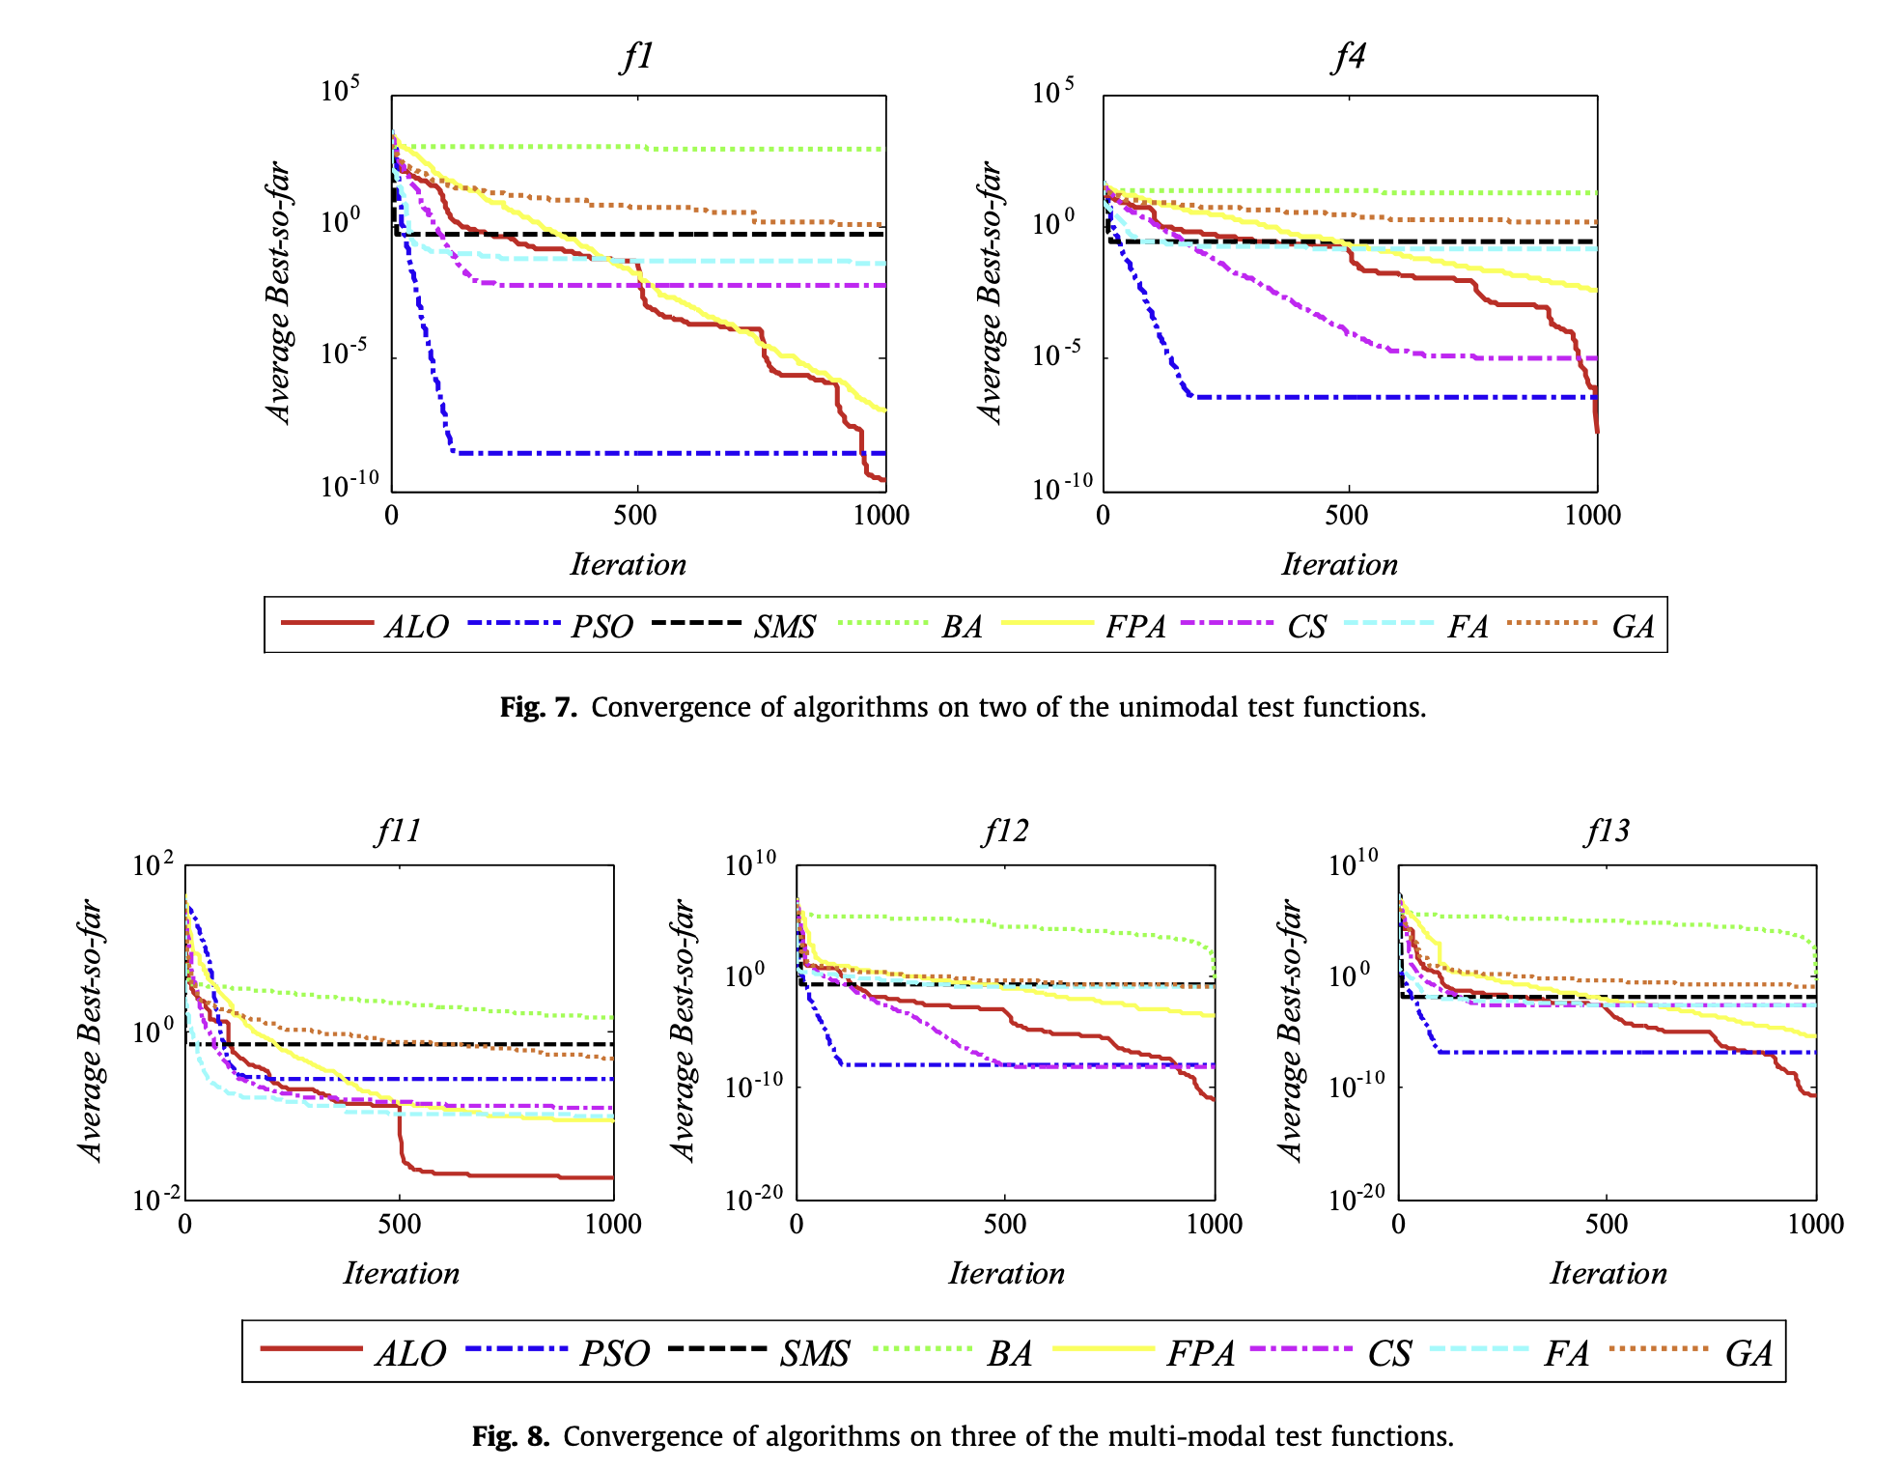

Slide 35
Conclusion:
The ALO algorithm showcases superior performance on both unimodal and multi-modal test functions, highlighting its effectiveness in optimization tasks.
These results affirm ALO as a promising optimization algorithm with broad applicability across different problem domains.

